Slide 1
Worship of Israel, Part 2

Slide 2
The Festivals
God commands Israel to gather 3 times a year to celebrate 3 Festivals:
Passover | Pentecost | Tabernacles
Early Spring | Late Spring | Fall
Barley Harvest | Wheat Harvest | Fruits & Vegetables
Unleavened Bread | Feast of Weeks | Feast of Booths
Remembers: the Exodus | Sinai Covenant God as King | Wilderness Wanderings
Notes:
To remind Israel what He has done for them and to strengthen their relationship with Yahweh, God commanded the people to gather, if possible near the tabernacle or temple, to celebrate three Festivals. The origin of these festivals were earlier harvest festivals that the people already celebrated, but now God gives these festivals a new religious meaning. There are other smaller feasts celebrated in Israel but these were the three major pilgrimage festivals. The above chart shows what type of harvest each feast celebrated and which part of their sacred history with Yahweh they commemorate.

Slide 3
Passover – a family centered occasion
Use unleavened bread – symbolizes sin – get rid of all leaven in your life.
Take your lamb to the temple to be inspected and butchered, take meat home to cook for the meal.
Drink four cups of wine, the third that Jesus uses for the Lord’s Supper = The Cup of Redemption
God redeems Israel, Jesus redeems new Israel
Notes:
Passover remembers the Exodus event, when God redeemed Israel from slavery in Egypt. This festival is family centered, eaten with family and friends in your home. It was also customary to invite poor people or people who had no family to eat the Passover in your home. On the original Passover each Israelite household in Egypt killed a lamb without disease or blemish, collected the blood at the foot of the doorway in a gutter (which was there to collect rain so it did not flood into the house), then used a hyssop branch to dip into that blood and smear blood above the door and on either side of the door. So there was the blood of a spotless lamb smeared around their doorway at the foot, head and on either side, the sign of the cross. And when the angel of death went throughout Egypt and killed the firstborn males of every household, it passed over the houses protected by the blood of the Passover lamb. After that last plague Pharaoh finally agreed to let the Israelites leave Egypt, and the Israelites were in such haste to leave, they made quick flat bread for the journey, without yeast. Later in history, when the family celebrated the Passover meal,, the head of the household took their lamb to the temple to be inspected, making sure it was a lamb free of sickness or injury. When the priests approved of your lamb, you slaughtered it at the temple, and took the meat home to cook for your Passover meal. The meal also includes unleavened bread, 4 cups of wine, and various symbolic foods eaten to remind the participants of various parts of the Exodus story. For instance, you eat sprigs of parsley dipped in salt water to remember that the Exodus was in the Spring and to remember the salty tears of your ancestors in slavery. You ate bits of horseradish to remind you of the bitterness of their slavery. There was a regular meal served in the middle of the symbolic, ritual part of the meal. Jesus celebrated the Passover with His disciples and took a piece of unleavened bread and said, “Take eat, this is my body.” He also took the cup of wine after the Supper, called the Cup of Redemption, and said, “Take and drink from this all of you, this cup is the new covenant in my blood, shed for you for the forgiveness of sins. “ Just as old Israel was saved by the blood of the Passover lamb, and was redeemed by God from slavery, so Christians believe that Jesus fulfills all of that and redeems us by His blood shed on the cross (The Final Passover Lamb) and saves us from our slavery to sin, death and the power of Satan.

Slide 4
Pentecost – from “50”; it is 50 days after Passover. Celebrated wheat harvest, but later also commemorated God’s covenant with Israel at Mt. Sinai and God’s enthronement as Israel’s king.
In NT times this was the Feast of choice to attend by pilgrims to Jerusalem, easier travel weather on the seas.
Tabernacles – They built huts or tabernacles and camped out in them to remember the time of God’s provision in the wilderness
Notes:
Many Christians are familiar with the word “Pentecost”, but not all of them know that this was an Old Testament festival before the events recorded in Acts 2, when the Holy Spirit fell upon the disciples to empower them for spreading the Gospel. In the New Testament story Jewish pilgrims from throughout the world were in Jerusalem to celebrate the festival of Pentecost, which not only gave thanks for the wheat harvest, but remembered God’s covenant with them at Mt. Sinai. And just as God’s presence was revealed in the Old Testament in a pillar of fire and the quaking of the mountain and a mighty wind, so also the presence of the Holy Spirit was seen in tongues of fire above the disciples heads and in a rushing wind. The Feast of Tabernacles, also called Succoth or the Feast of Booths, fell around the Fall harvest of olives, grapes etc. and commemorated God’s provision during the 40 years of wandering in the wilderness. People then (and still today) built a tabernacle or shack made of wood branches and leaves, usually in their yard, and live in them during the days of the festival.

Slide 5
Passover | Pentecost | Tabernacles
Lent & Easter | Christ’s Enthronement & Coming of the Holy Spirit | Advent & Christmas
Notes:
The cycle of religious festivals in the Old Testament corresponds to the three major festivals and seasons of the Christian liturgical calendar. We know that Holy Week (Jesus’ last week, starting with Palm Sunday and ending with His death on Good Friday) were during Passover week. And Jesus rose from the dead on the Sunday after the Passover (which was on Maundy Thursday that year), so the season of Lent (ending in Holy Week) and Easter correspond with Passover in the Jewish calendar. 50 days later is the Jewish festival of Pentecost, which Christians now celebrate as the coming of the Holy Spirit upon the disciples to spread the Gospel and grow the Christian Church. And the Fall festival of Tabernacles (along with the wo other feasts: Trumpets and Yom Kippur) roughly correspond to the 4 week season of Advent, which looks forward to Jesus’ first coming at Christmas and His Second Coming at the end of time.

Slide 6
Day of Atonement – Yom Kippur, 5 days before the Feast of Booths. Most somber & holy day in Israel’s religious calendar. The day all the sins of Israel are dealt with & forgiven.
Only the High Priest can go into the “Holy of Holies” this one day each year to first offer a blood sacrifice for his own sins on top of the ark, and then an offering for the people’s sins.
The blood sprinkled on the “mercy seat” – the place that God atones for our sins
Notes:
On the Day of Atonement, the High Priest enters the Holy of Holies (Most Holy Place) in the tabernacle/temple (the only day anyone is allowed to enter there, to sprinkle the blood of a bull on the lid of the Ark of the Covenant. The Ark was considered God’s throne on earth and the lid (which had two gold archangels touching their wings over it) was called “the Mercy Seat” for there God showed mercy to Israel and forgave their sins because of the blood covering of an animal substitute. It is interesting that St. Paul calls Jesus our “Mercy Seat” – the place where God dispenses mercy on us because of Jesus substitutionary sacrifice for our sins.

Slide 7
Scapegoat ritual used to drive Israel’s sins away from God’s presence and out into the wilderness.
The Tabernacle is God’s Holy Tent – it is His portable palace; the ark – His throne.
Horizontal Typology is along a time line, i.e. David is a Type of Jesus to come later in human history.
Vertical Typology is when something on earth is a model of something greater going on in heaven at the same time.
Notes:
There was another ritual on the Day of Atonement, where the High Priest cast lots over two goats to see which one would be “the scapegoat.” The scapegoat has the sins of Israel confessed on it, as if those sins are symbolically transferred to the goat, and then that goat was driven away from the temple and Jerusalem, out into the wilderness, taking Israel’s sins away from the Holy City. We discussed Typology earlier. One more distinction is that Horizontal Typology is along a time line, so, for instance, King David as the great king and shepherd of Israel becomes a type of Jesus the King of kings and the our Good Shepherd who lays down His life for us. Vertical Typology is when something on earth is a type of something greater in heaven.

Slide 8
The chief Vertical Typology in the OT is that of the Tabernacle and later Temple.
God is really present in a sacramental way with His people in the glorious cloud, above the ark, in the Tabernacle; which is a model of God’s greater and fuller presence with people in heaven.
The cloud = His Glory = His presence
Notes:
Just as in God’s earthly temple He showed His presence in the pillar of cloud or fire (which is called His Glory), and just as God’s people worship Him in His earthly temple and God dwells among them, so at the same time, beyond our time and space, God is on His heavenly throne and is worshipped by His people who have entered their heavenly existence. Jerusalem and its temple are types of heaven, the Holy City where God dwells among His people in perfect peace and joy.

Slide 9
Holy Land
Holy City
Holy Temple
Most Holy Place
Notes:
God’s presence, His glory, makes what He touches holy. Holy mans “set apart” – set a part for sacred use; touched by God. So the most enter room of the temple where God’s visible presence dwelt was “the Most Holy Place”, then, moving out from there was The Holy Temple, then the Holy City Jerusalem, then the Holy Land of Israel. God’s presence makes things holy. This is why, in the New Testament, the word “saint” is never applied to some special class of people, but to all Christians. Christians are called saints because they are made holy by being covered with the holiness of Jesus. So the Christian Church, all who come to faith in Jesus, are the New Holy Temple of God; the new Holy City and Holy Land.

Slide 10
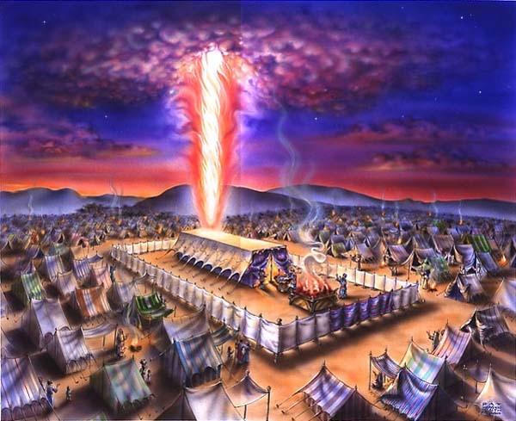
Notes:
An artist’s depiction of the Tabernacle in the Sinai wilderness, with God’s glory or presence coming out of the Most Holy Place inside the sanctuary, and the 12 tribes of Israel encamped around God’s presence. You will also see the Altar of Burnt Offering toward the front of the tabernacle court, on fire from offerings being sacrificed to Yahweh.

Slide 11
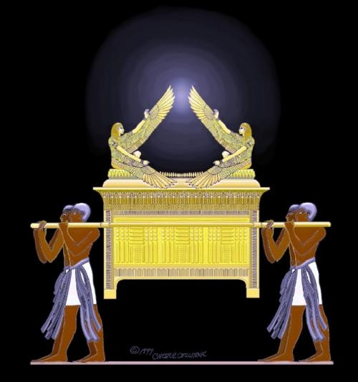
Notes:
An illustration of what the Ark of the Covenant could have looked like.

Slide 12
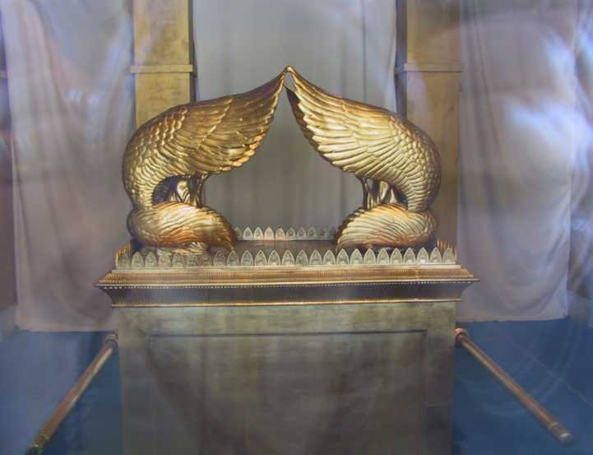
Notes:
Another illustration of the Ark of the Covenant.

